Slide 1
Thomas Jefferson High School Amateur Radio Club Vienna Wireless Society
Direct Conversion Receiver Project
Spring 2023

Slide 2
Let’s Build a Ham Radio Receiver

Slide 3
Goal: Students build ham radio receivers
All circuits analog, with discrete components. No integrated circuits.
Can be understood at component level.
Gain experience in circuit and PC board design.
Do something that is hard. That is a challenge. That most hams will NEVER do! We are builders, tool-makers.

Slide 5
This is NOT easy!

Slide 6
Our Direct Conversion Receiver
-- It will operate on the “40 meter” ham band. 7.0 -7.3 Megahertz
-- With it, you will listen to voice, morse code, and digital signals.
-- This is a real receiver – not a toy. You could build a transmitter and make contacts with it. You can decode the digital signals.

Slide 7
What is Direct Conversion?
The signals this receiver will work with are ELECTROMAGNETIC WAVES at about 7 million cycles per second.
But our ears respond to acoustic waves in the air at around 3 to 3000 cycles per second.
We need to CONVERT the radio signals to sound waves that we can hear.
We do this CONVERSION DIRECTLY. Thus: Direct Conversion.

Slide 8
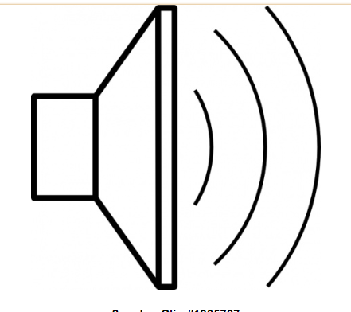
A Block Diagram of our Receiver
Bandpass
Filter
Mixer
Audio Amplifier
Oscillator
(VFO or PTO)

Slide 9
How it works: Just Four Stages
Bandpass filter: There are a LOT of radio signals out there: This stage takes radio signals from the antenna and filters out all EXCEPT those of the frequency we need: 7 to 7.3 MHz. It lets this BAND OF FREQUENCIES pass. Bandpass.
Mixer: Really important. Takes the signal we create in the oscillator and mixes it with the signal from the bandpass filter. A Fourier transform takes place, so at the output of the mixer we have both sum and difference frequencies. We throw away the sum (around 14 MHz) but we keep the difference (AUDIO from 3 to 3000 cycles per second!)

Slide 11
How it works:
OSCILLATOR: This produces the signal that we mix with the signal from the bandpass filter. Like a cat chasing its tail: Output reaches the input. Like a microphone that gets too close to a speaker and squeals. We will build one today. Also called the VFO or the PTO. We use a PTO.
AUDIO AMPLIFIER: Takes the very weak signal from the mixer and amplifies it to the point where we can hear it coming from the speaker or headphones. The most complicated stage.

Slide 12
TODAY! Let’s build the oscillator!
-- One stage at a time. Today we will build the oscillator.
-- Manhattan Style Construction. Copper clad boards with isolation pads superglued to them. This is very basic PC board design.
-- Building an oscillator like this is a wise first step.

Slide 13
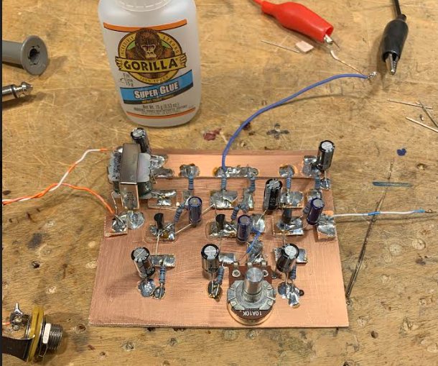
Manhattan Style Construction: What are isolation pads and where do we need them?

Slide 14
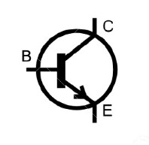
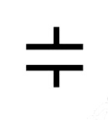
Some Electronic Symbols we will use
Transistor
Resistor
Capacitor

Slide 15
More symbols
Coil
Zener Diode
Battery
Ground (to copper clad)

Slide 16
Today’s Build:

Slide 17
What is an oscillator? The beating heart of the receiver!

Slide 18
What to know for today.
-- This is an amplifier with some of the output fed back to the input. So it “takes off” and oscillates. Feedback from the top of R3 to C1/C2.
-- The 2N3904 transistor is the heart of this circuit. It amplifies the signal and – with power from the battery – keeps the oscillation going.
--- The frequency of the oscillation is set by the resonant circuit of L1, C1 and C2.

Slide 19
Let’s build it today!
We will demonstrate the oscillator build today.
At the end, we will look at the output signal on oscilloscopes, and listen to the signal on radio receivers.
We will – in essence – have built small radio transmitters!
We will use them as the heart of our receivers.

Slide 20
Resources for Reference
Excellent Diagrams on our receiver (from Rick N3FJZ who built it):
http://www.remmepark.com/circuit6040/SolderSmoke-DCR/SolderSmoke-DCR.html#AUDIO_AMP
16 SolderSmoke Blog Posts about the TJ Receiver and its development:
https://soldersmoke.blogspot.com/search/label/TJ%20DC%20RX
The simulation of our receiver (.asc file) and other info:
http://bit.ly/3WAFfLI

